Slide 1
BIM460 Software Modelling Visitor Design Pattern
11/05/2010
Osman Emre KARAGUL
Contact: twitter.com/osmnEmreKaraguL

Slide 2
There will be following topics:
Objective of Visitor Pattern
What is Double Dispatch?
An example
Structure of Visitor Pattern
Visitor in UML,
Code snippet
Questions?

Slide 3
Objective
Problem: Node objects in a heterogeneous aggregate structure;
Many distinct and unrelated operations need to be performed on node objects,
avoid “polluting” the node classes with these operations,
do not query the type of each node and cast the pointer to the correct type before performing the desired operation

Slide 4
Objective (conts.)
Solution: Visitor design pattern
Visitor lets you define a new operation without changing the classes of the elements on which it operates,
Double dispatching via a two-way polymorphic handshake

Slide 5
What is Double Dispatch?
The particular implementation to use may vary depending on the class of two arguments instead of just one:
the class of operation to be performed, and
the class of the object to operate on.
This is called double-dispatch.

Slide 6
A real-life example
This pattern can be observed in the operation of a taxi company.
When a person calls a taxi company (accepting a visitor), the company dispatches a cab to the customer.
Upon entering the taxi the customer, or Visitor, is no longer in control of his or her own transportation, the taxi (driver) is.

Slide 7
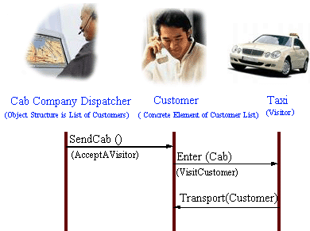
The operation of a taxi company

Slide 8
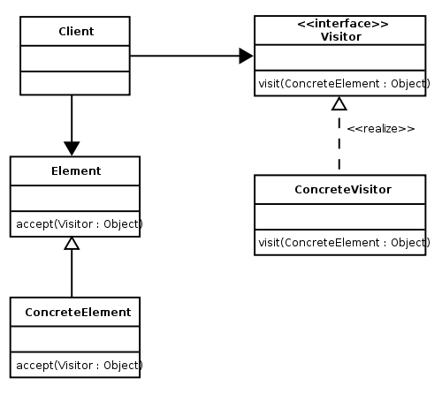
Structure of Visitor Pattern
Visitor in UML
Code snippet ☺

Slide 9
Thank you
for your attention.
Questions?

